Slide 1






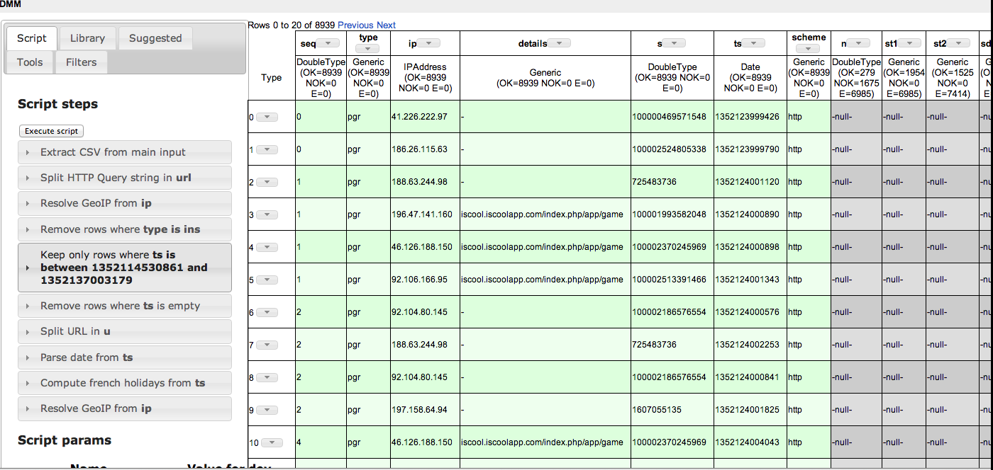
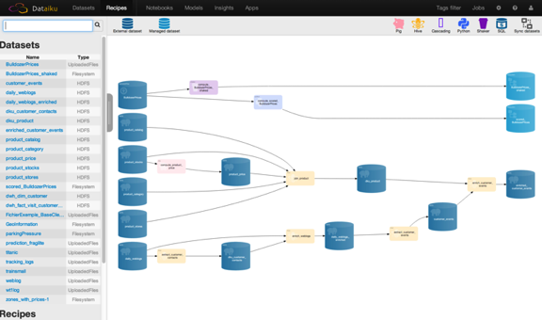
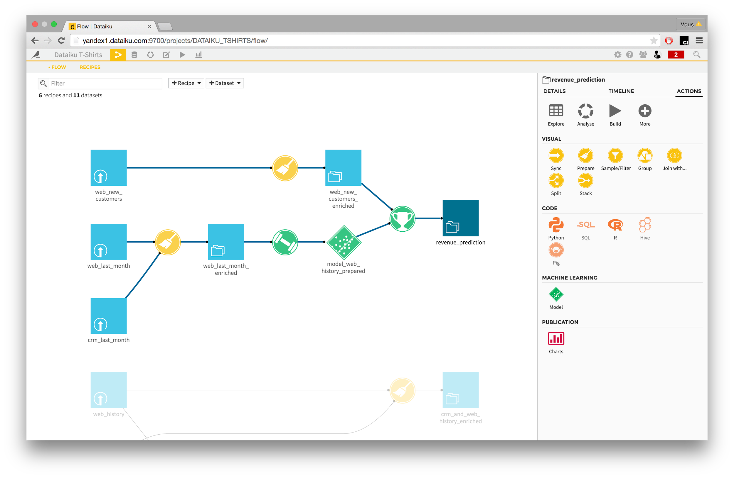
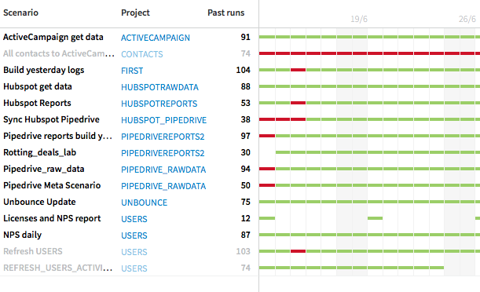
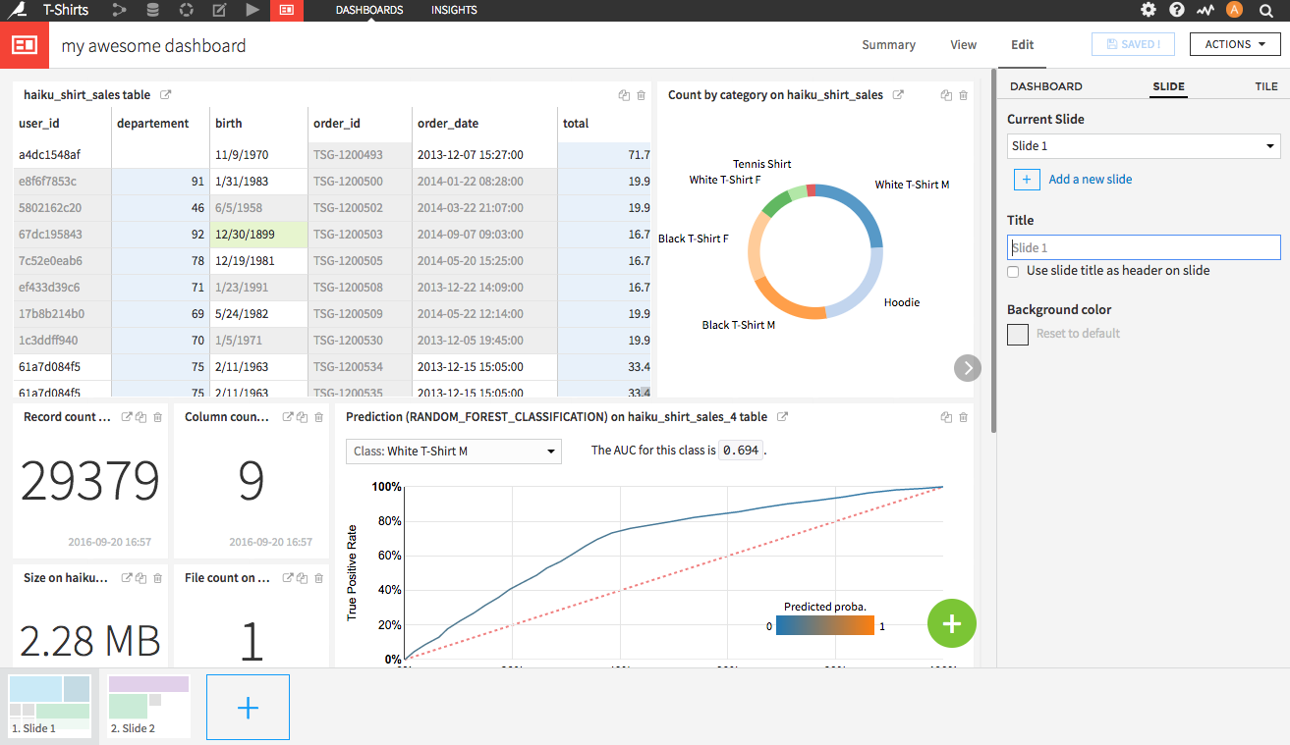
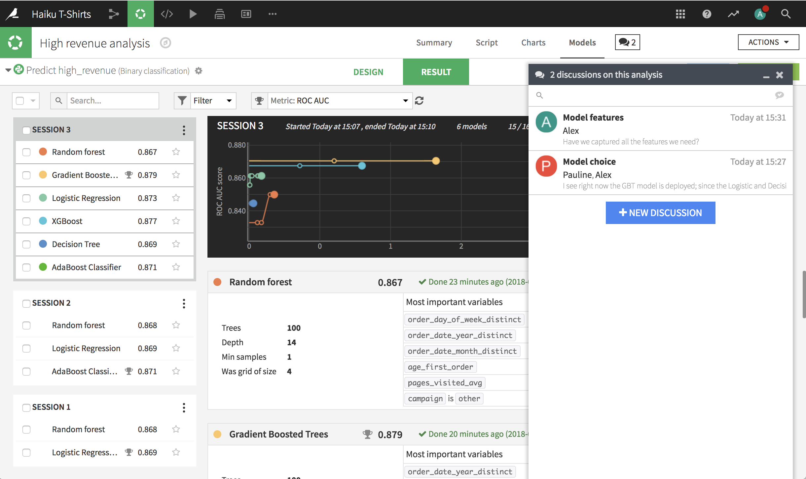
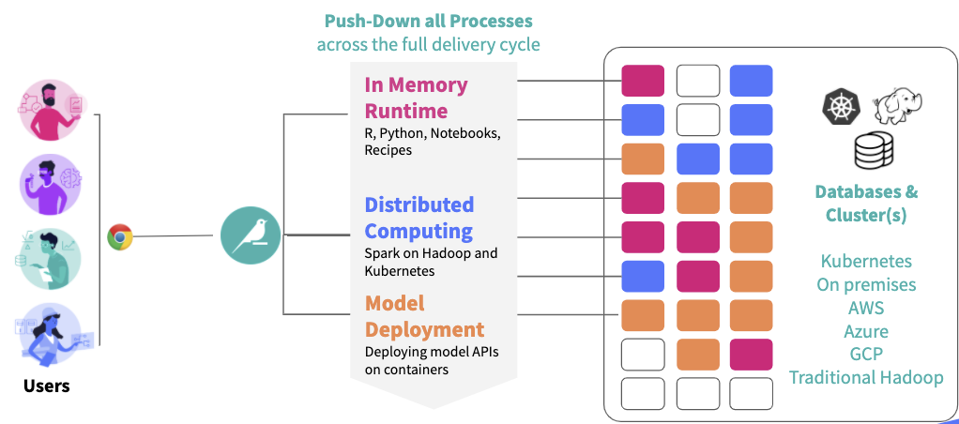
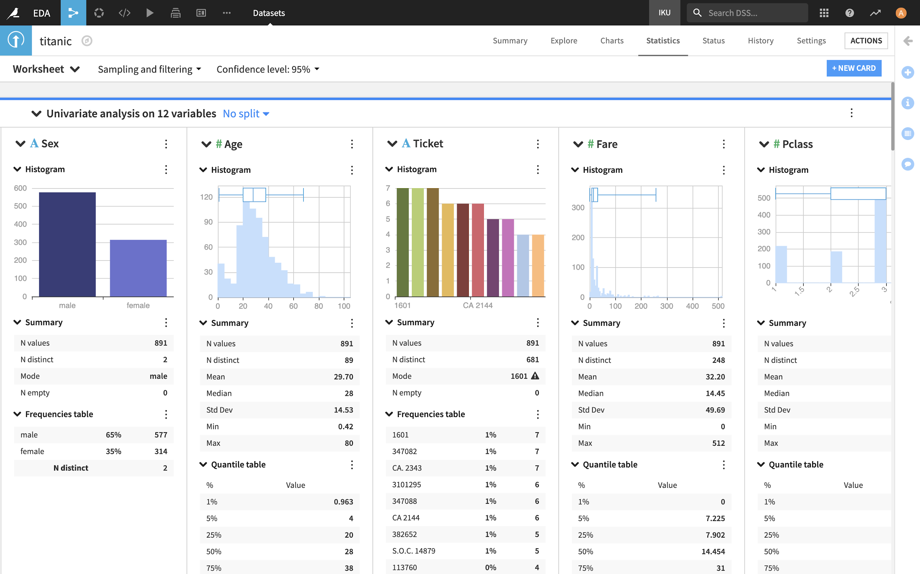
Key Company Milestones
A Brief History of Dataiku
2013
2014
2015
2016
2017
2018
2019
2020
Dataiku Created
20th employee
100th employee
200th employee
400th employee
COMPANY
Office in New York
Office in London
7 new offices in EMEA, APAC, Americas
$4M raised
$14M Series A
$28M Series B
$101M Series C
$1.4B valuation
50th
customer
100th
customer
1st CAB
Customer Advisory Board
300th
customer
CUSTOMERS
First customer
1000+
EGG Visitors
First 10+
users customers
First 100+
users customers
First 500+
users customers
First 1000+
users customers
SOFTWARE
Beta
version 1
1st tool integrating
data prep and ML
version 2
Real-time collaboration
Spark integration
version 3
Scenarios, automation and version control
version 4
Advanced scalability,
cloud support
version 5
Deep learning, Containerization, Project wikis
version 6
Enterprise Scale Elastic AI with Kubernetes
version 7
Explainable AI and
Advanced Visual Statistics
Notes:
- Here is a brief overview of Dataiku’s history
- Dataiku was founded in 2013 in Paris, gained 1st customer using a beta. Since then it has grown quickly, opening an office in NYC, London, Singapore, Austrialia, and 3 rounds of funding, our 300th customer & 400th employee (size of clients install growing)
- Most recently, in December 2019, we’ve announced that CapitalG, the investment arm of Alphabet Inc. (holding company for Google) invested in Dataiku at a 1.4B USD valuation!! This shows clear trust and validation from investors and customers.
- DSS version 7

Slide 2
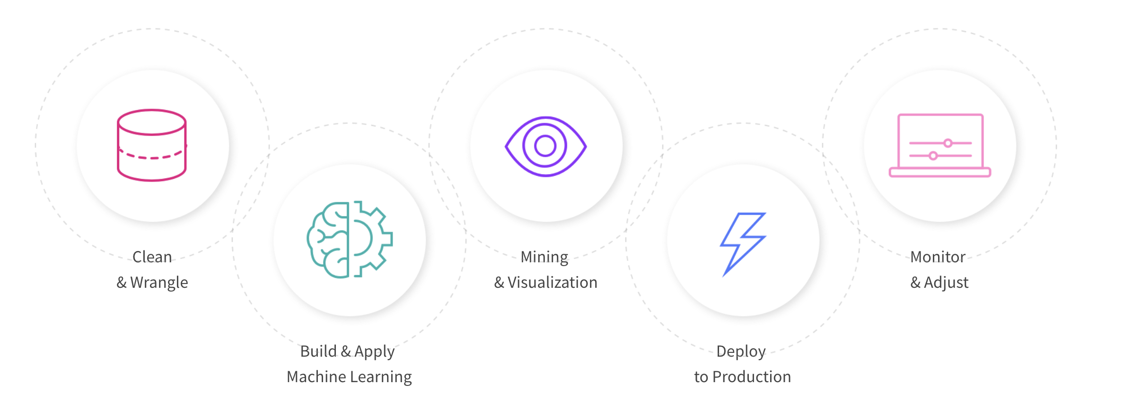
Dataiku DSS (Data Science Studio)
End-to-end Software

Slide 3
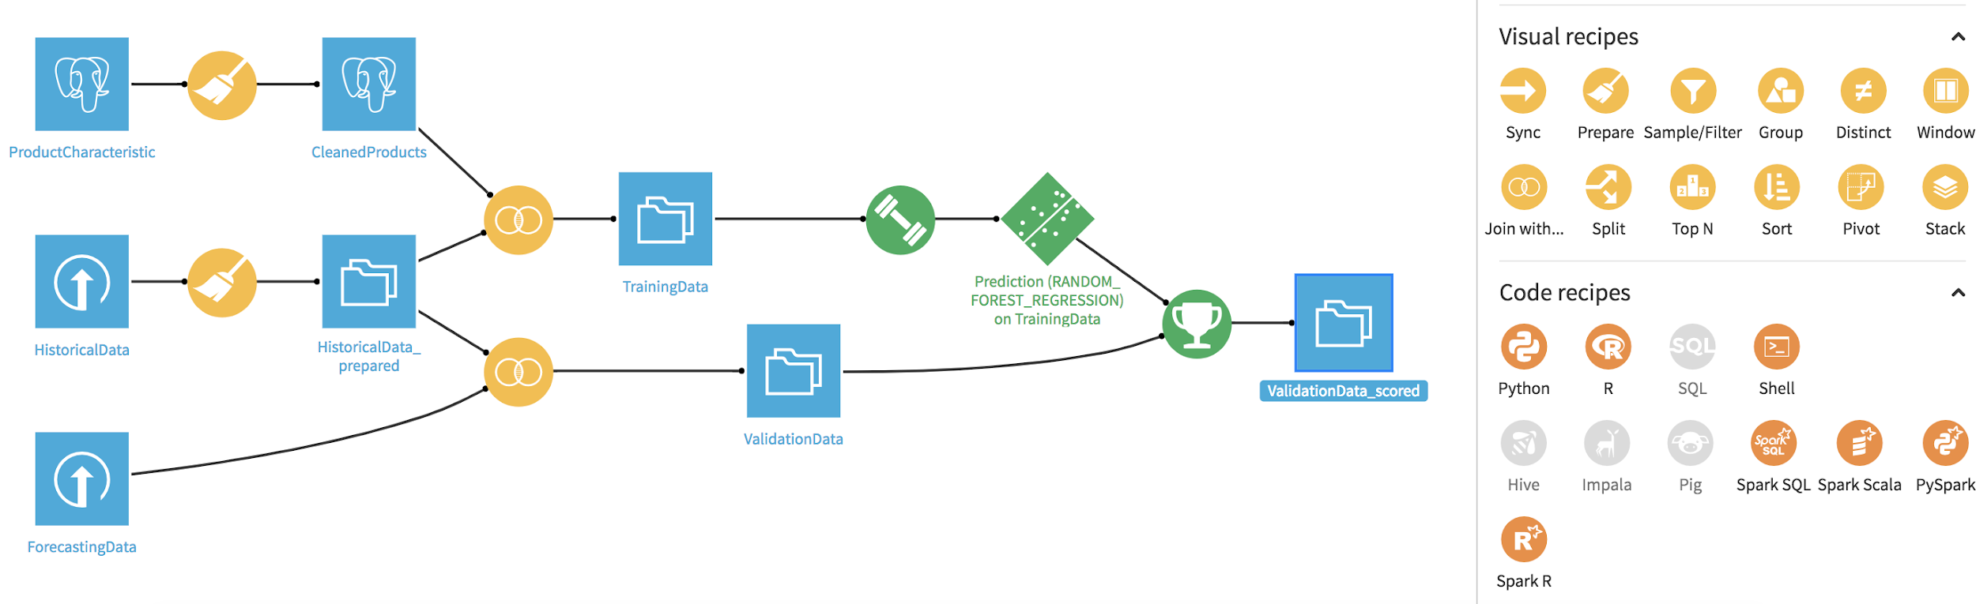
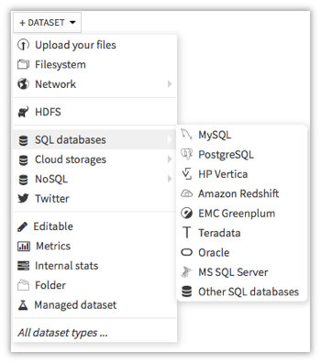
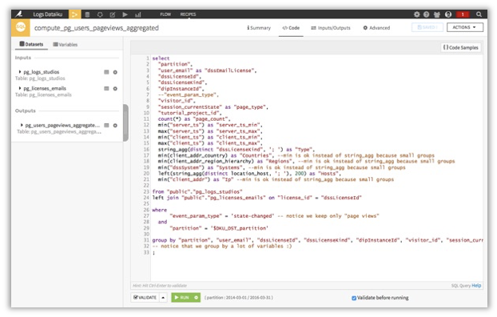
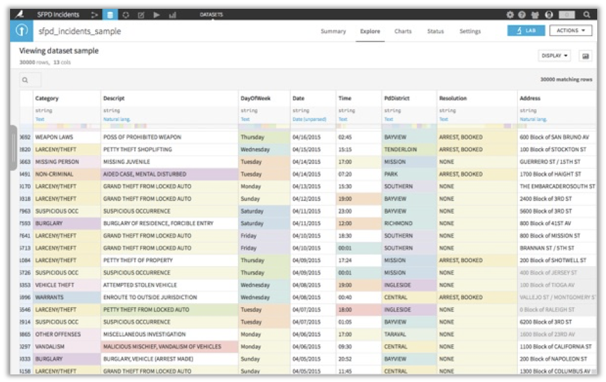
Dataiku DSS
Data Access and Processing
DEVELOP REUSABLE/MAINTAINABLE DATA FLOWS
CONNECT TO YOUR (MANY) DATA SOURCES
Simple representation of overall data processing despite complexity of underlying operations
Portability of in-built recipes to various execution engines
Click based connection to your datalake, databases, flat files or any other source
Native connectors for most common technologies (SQL, Hadoop, Spark, NoSQL…)
Find relevant data with the catalog
CODE… OR CLICK
Code in your language of choice (R, Python, SQL…)
Use the 100 in-built processors to perform advanced operations in a few click
Package your specific processes in reusable click based plugins for wide usage
UNDERSTAND YOUR DATA
Directly navigate through data samples and compute the key
Build immediate visualisation for self- or shared- use
LEVERAGE VARIOUS COMPUTE RESOURCES
Push process execution in your databases or computation clusters
Deploy via containers or spin up compute resources

Slide 4
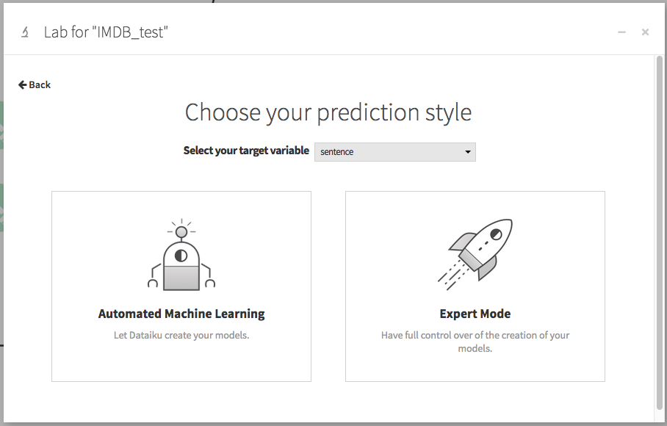
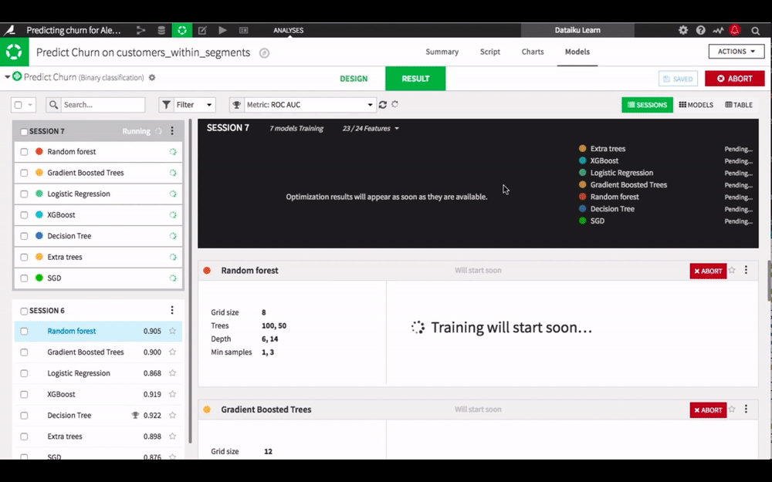
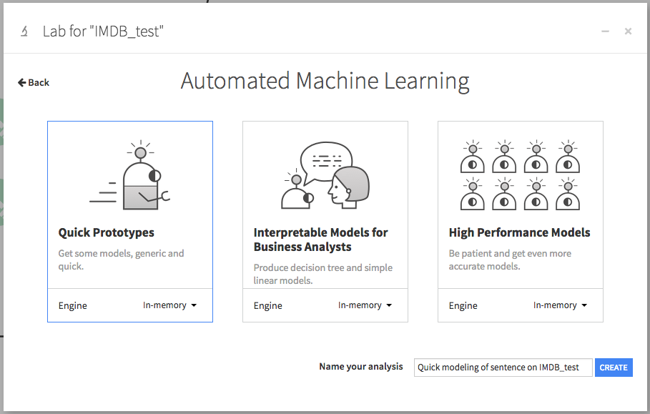
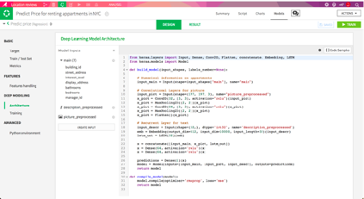
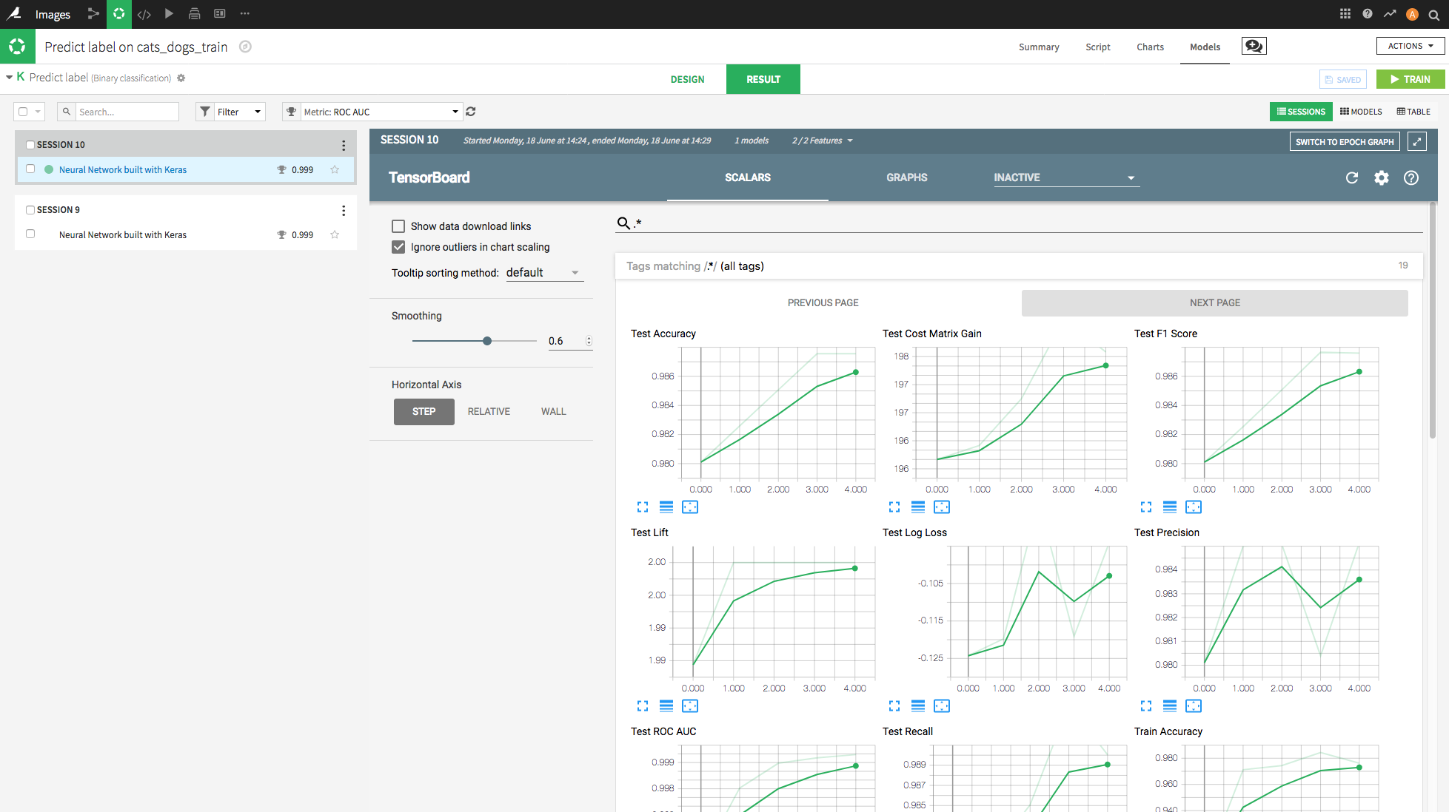
Dataiku DSS
Machine Learning
AUTO-ML OR CODE BASED
FULL TRAINING MANAGEMENT
Create, improve, and automatically compare multiple machine learning models in a few clicks
Leverage the best ML libraries in the way most suited to your users
Track model performance
Historize trainings, setup and sessions
Select best performers or revert to past designs
Update your model with ease: add new data, create new variables in your models, and check the variation (%) in the core metrics

Slide 5


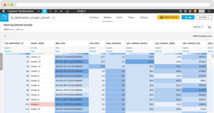
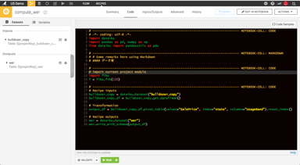
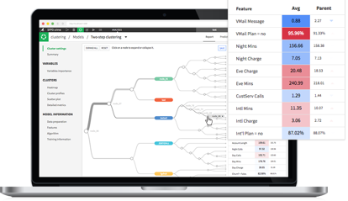
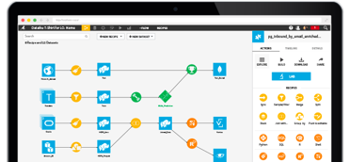
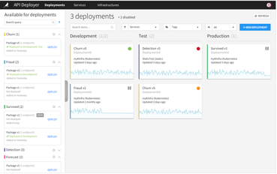
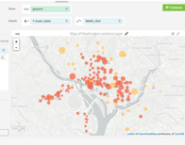


Solution Overview: An End-to-End Solution
From Data Access to Operationalized Models
Build
plugins for….
Build
plugins for….
Build Business Monitoring
Dashboard For…
Business Analyst
Data Scientist
Business Analyst
Integrate Work
Together in …
Data Scientist
Business Analyst
Find Understand Prepare Data
Business
Modelling Prototype
Monitor
Results
DATA MANAGEMENT
MACHINE LEARNING
MODEL DEPLOYMENT
VISUAL AUTO PREP
CODING ENVIRONMENT(S)
VISUAL AUTO ML
VISUAL PIPELINE
MODEL DEPLOYMENT
VISUAL MODEL MONITORING
Understand
Progress
Optimize
Speed
Integrate
Use For Productivity
And Extend
Use as a Baseline
Use for optimization
Monitor
Results
Data Scientist
Analytics Leader
Data Engineer
Analytics Leader
Notes:
Talk about the different profiles that can leverage DSS capabilities and collaborate on projects

Slide 6
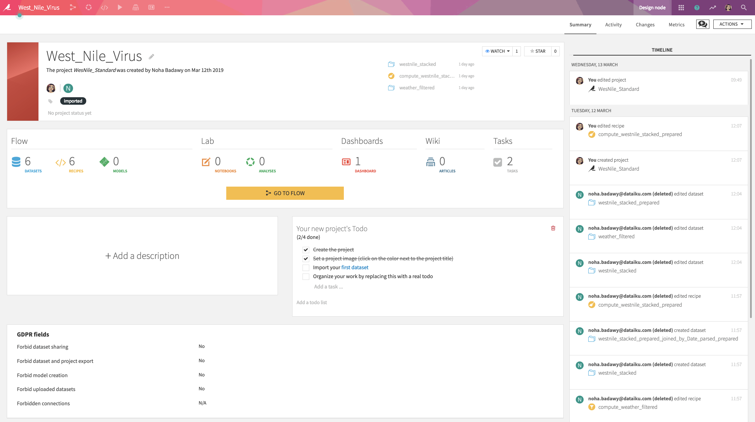
DSS Concepts
Project
Notes:
This is the home page for a typical project
Is a container for all your work on a particular activity.
The project home acts as the command center from which you can see the overall status of a project, view recent activity, and collaborate through comments, tags, and a project to-do list.

Slide 7
DSS Concepts
Flow, Datasets, Recipes
Notes:
The Flow is a visual representation of your work as a set of dependencies between datasets and the recipes used to produce them
The knowledge of these dependencies helps the Dataiku DSS engine minimize the number of data processes to be launched when (re)building a dataset.

Slide 8
DSS Concepts
Project, Flow, Datasets, Recipes
Notes:
DSS recipe is a set of actions to perform on one or more input datasets, resulting in one or more output datasets. Each time you prepare, join, group… your datasets, this will be through a recipe. A recipe can be visual or code.
A visual recipe allows a quick and interactive transformation of the input dataset through a number of prepackaged operations available in a visual interface.
in DSS flow they appear in Yellow circles
A code recipe allows a user with coding skills to go beyond visual recipe functionality to take control of the transformation using any supported language (SQL, Python, R, etc)
in DSS flow they appear in Orange circles

Slide 9
Skill agnostic platform that supports all data project stakeholders
End-to-End Platform Solution
DATA CATALOGING AND CONNECTIVITY
DATA PREPARATION
(AUTO) MACHINE LEARNING
PRODUCTION DEPLOYMENT
VISUAL
CODE
GOVERNANCE, VERSIONING, AUDIT AND REUSE
Notes:
Different profiles mapped to differents parts of the entire project
You can design and conduct a full End2End projects or your job could be just to connect to the datasets and clean them, another team member could be building a model ...etc

Slide 10
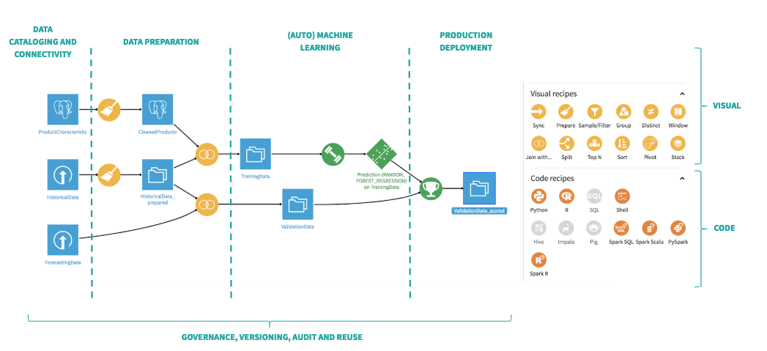
Skill agnostic platform that supports all data project stakeholders
The first part of our training will focus on building the project
Notes:
The training today will be focused on Visual recipes, you don’t need to code

Slide 11
Skill agnostic platform that supports all data project stakeholders
The second part of our training will focus on best practices
How to share a project
How to reuse parts of a project
How to restrict access
How to tag the steps and the datasets in your project
and more…

Slide 12
Super Quick Demo!

Slide 13
Hands on!
Data Preparation

Slide 14
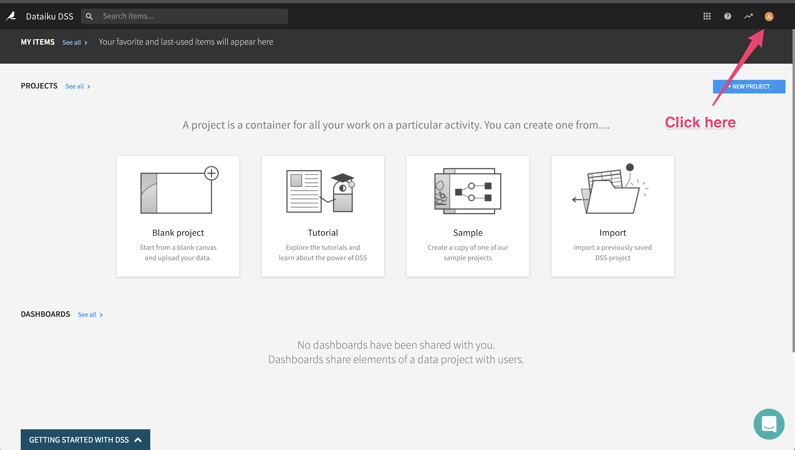
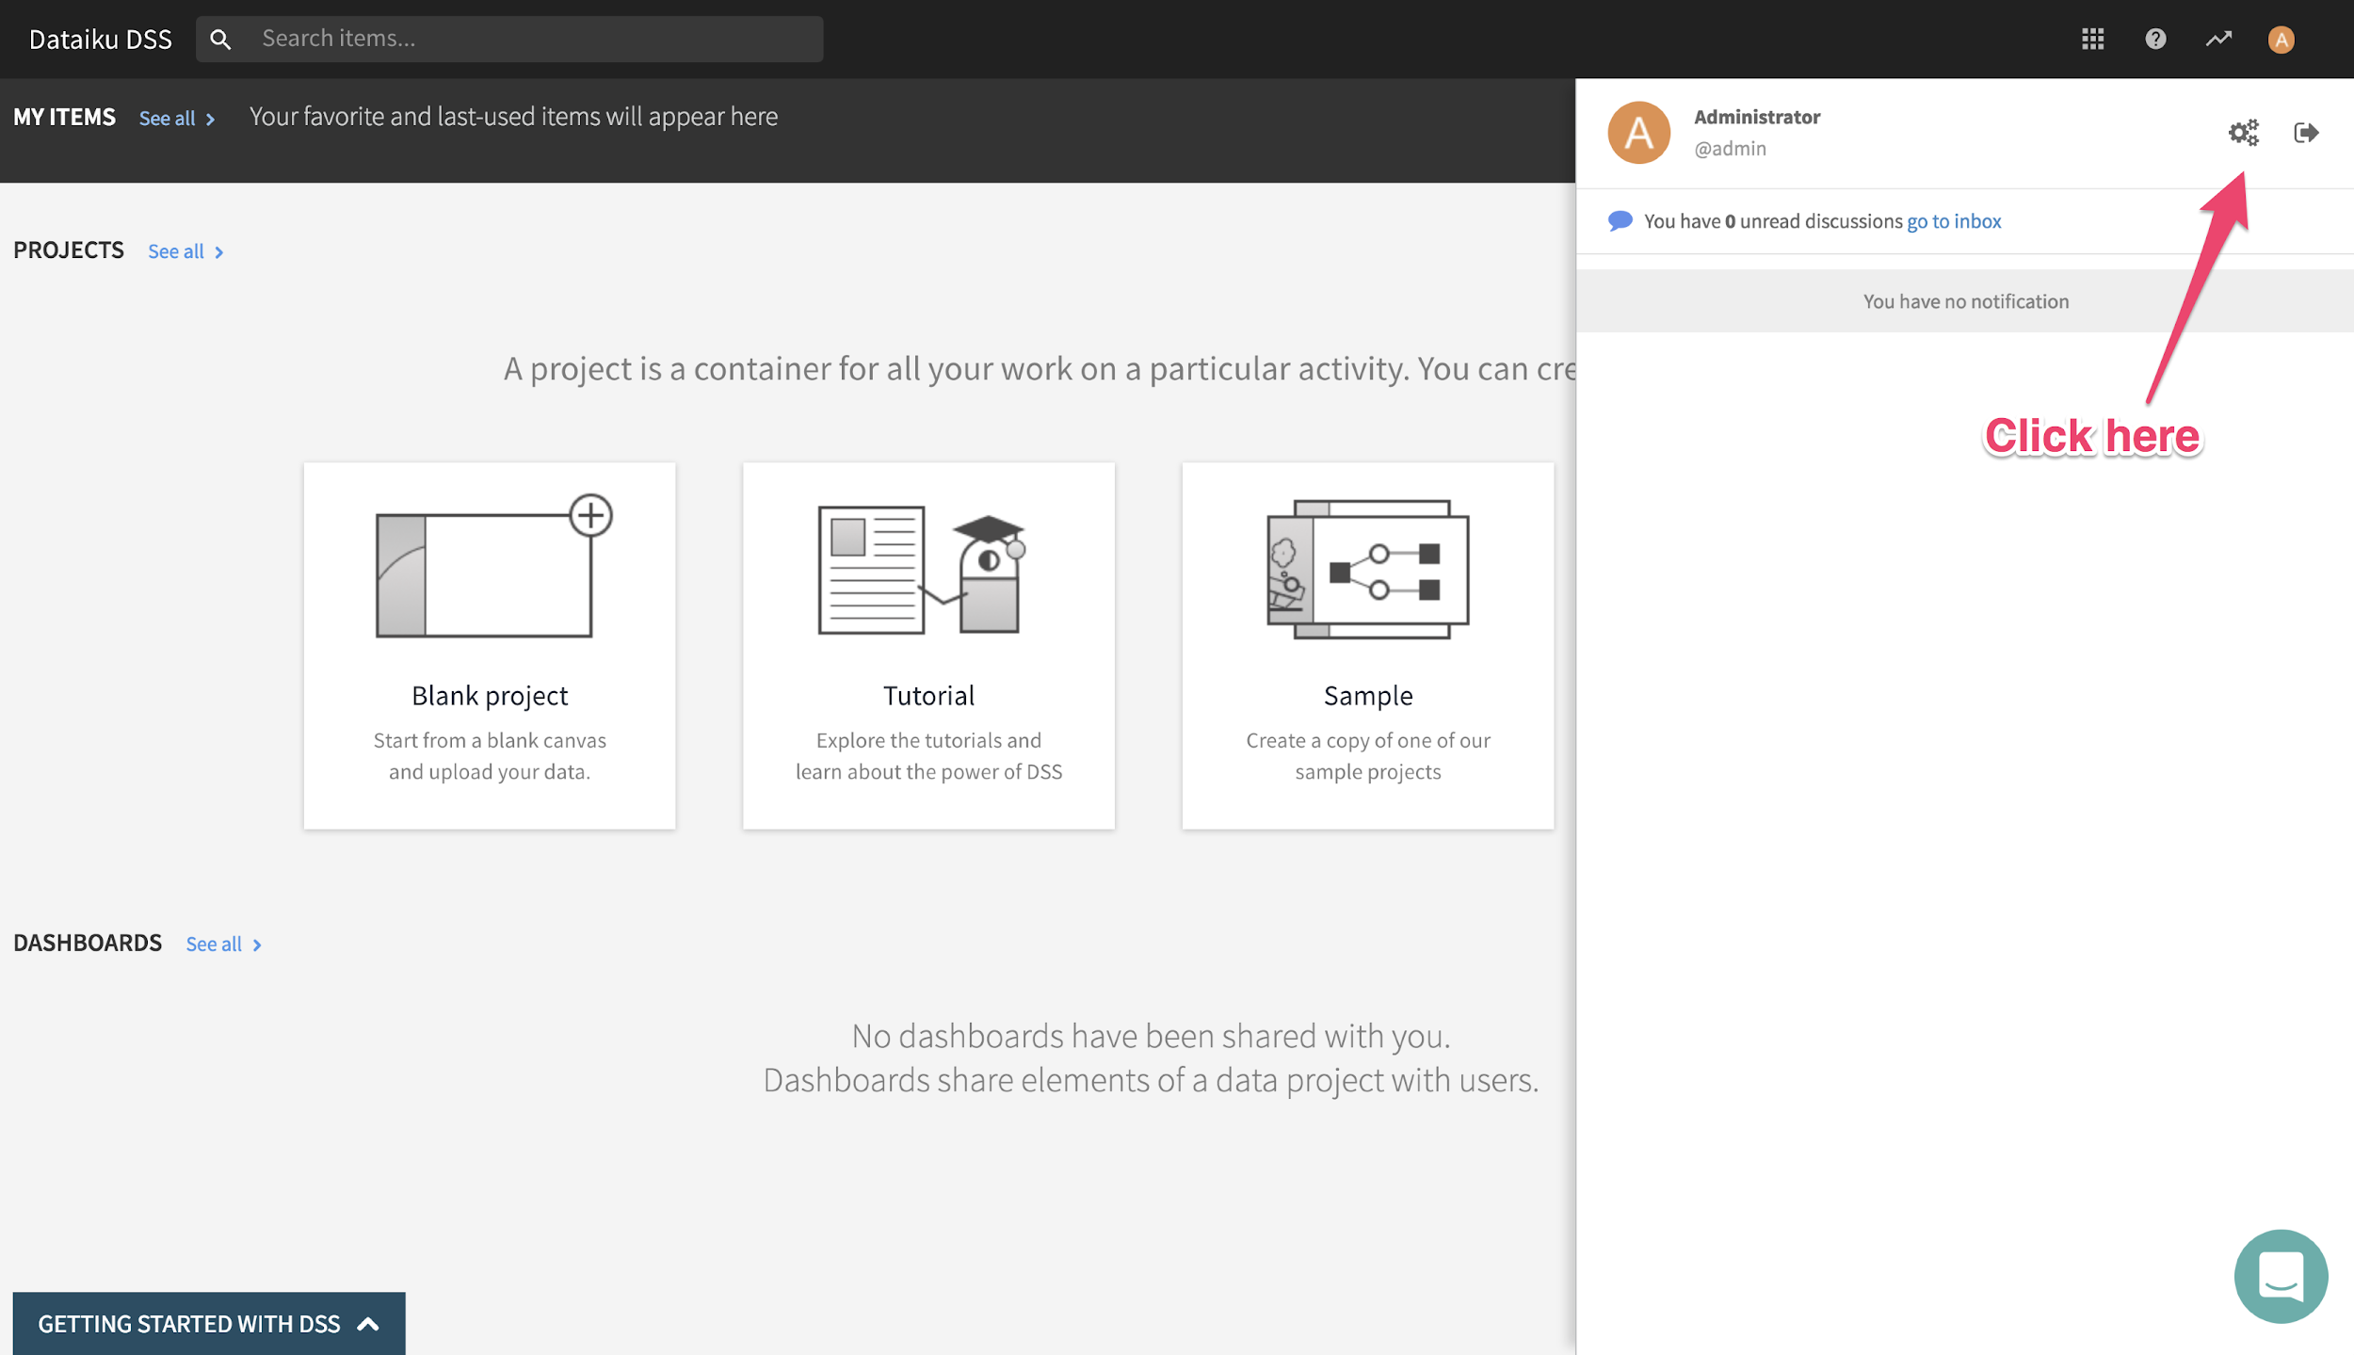
Set up your user profile
Change your display name and add your profile picture
Notes:
setting up users profile

Slide 15
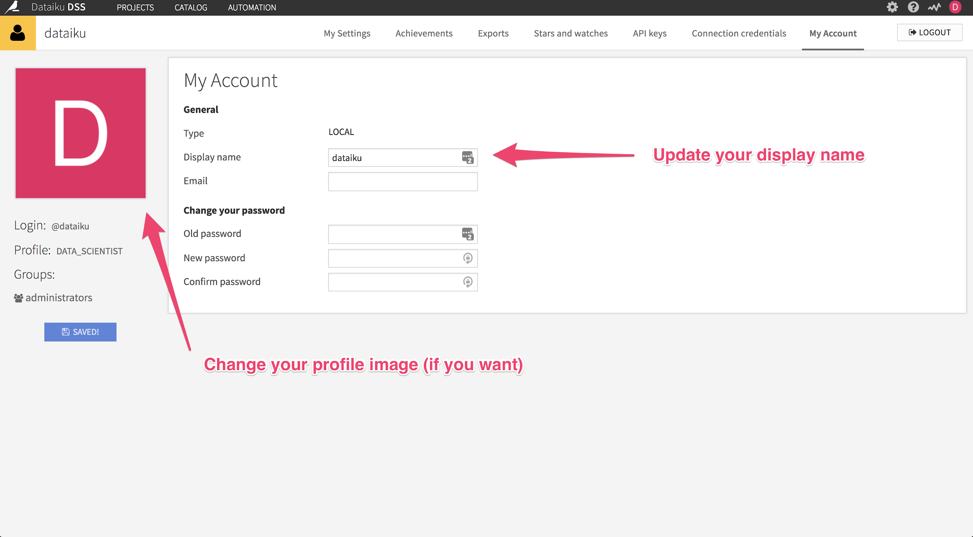
Set up your user profile
Change Image, Update your display name
for later, you can setup your own password from this screen

Slide 16
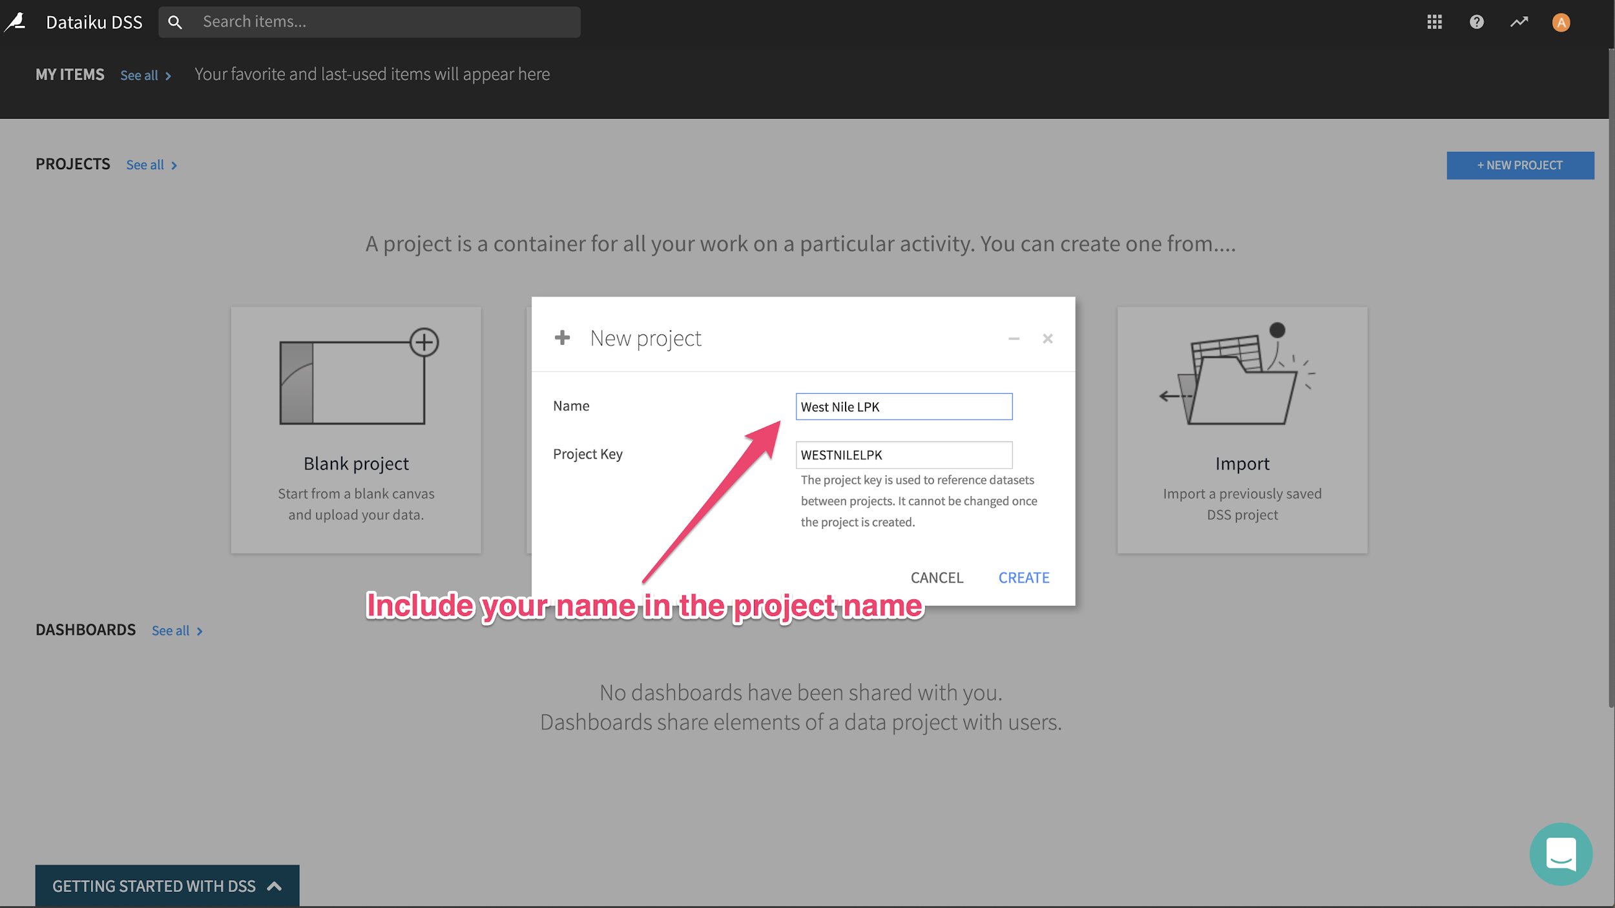
Set up your user profile
Create your first project

Slide 17
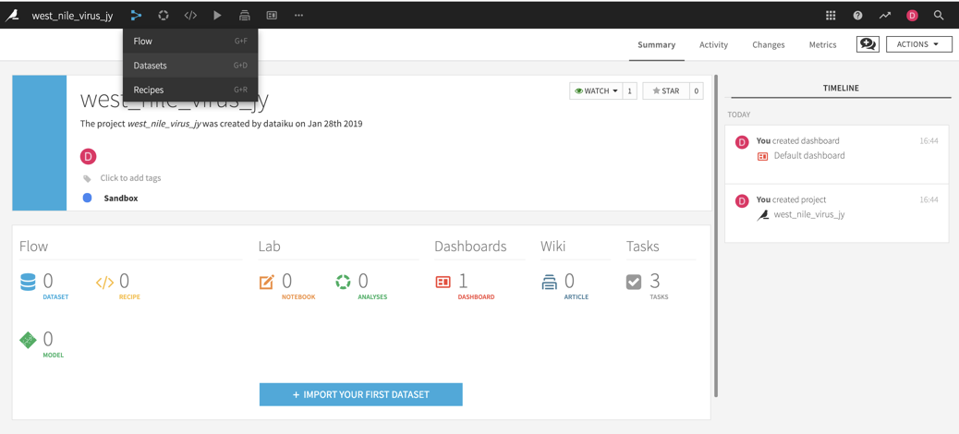
Check the information provided on the home page for your project
quiz: how many datasets and dashboards does this project have?

Slide 18
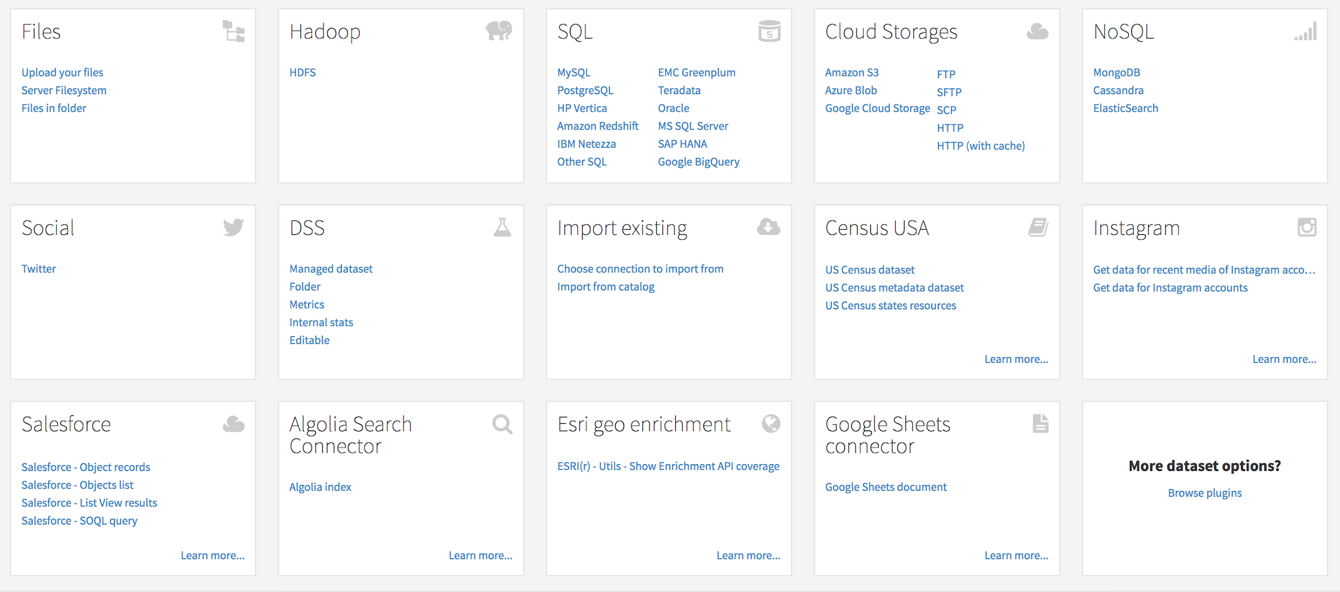
Upload dataset
Quiz: can I connect to social media?
Notes:
Talk about the different data sources that the user can connect to and feel free to give them little quiz on available social media connections

Slide 19
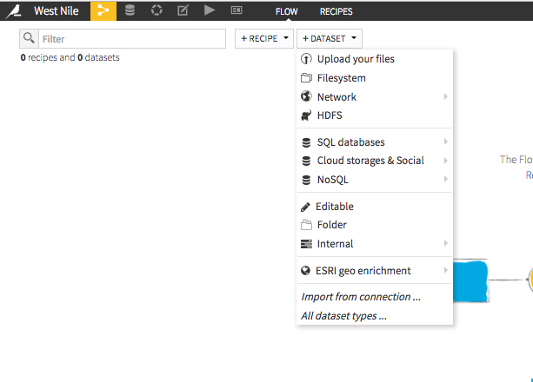
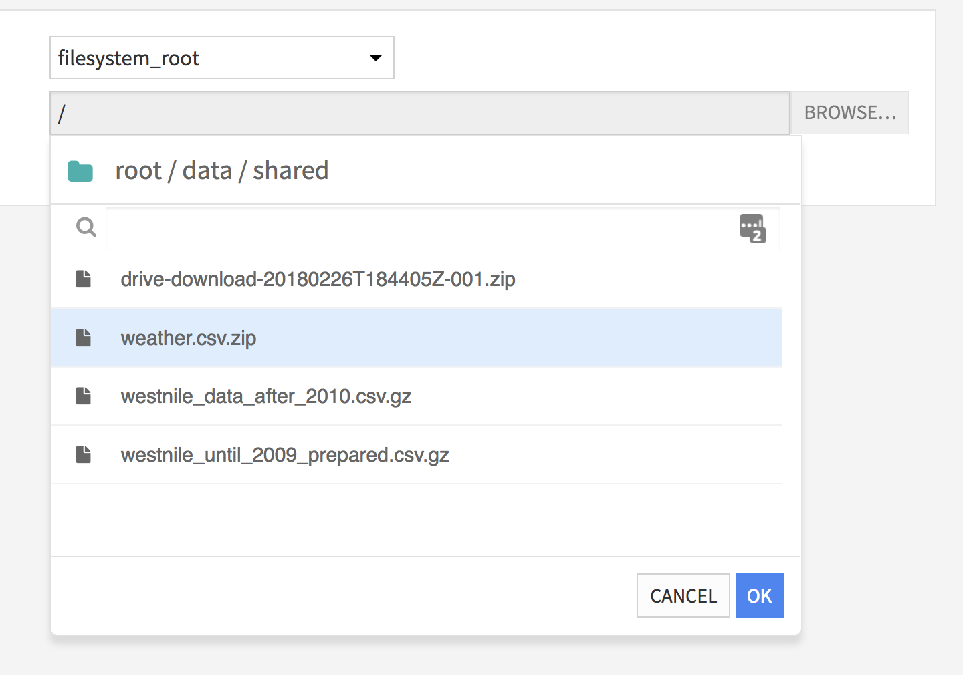
Let’s get the data...
upload datasets
There are various ways to upload your dataset into your project:
let’s upload
westnile_until_2009.csv.gz
Notes:
the first dataset is available on filesystem root

Slide 20
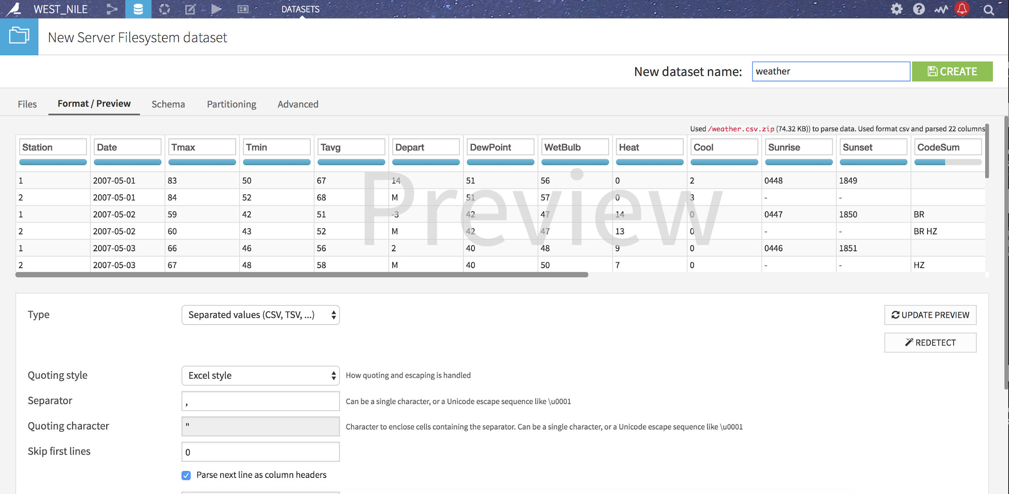
Let’s get the data...
Preview the data
Notes:
Spend time explaining the “Review” and the naming conventions for datasets

Slide 21

Let’s get the data...
upload datasets
Now, let’s get the second dataset available for us to use in this project
One of your team members will be sharing it with you from another project he/she has worked on
westnile_data_after_2010.csv.gz
Refresh your page and it will appear like this:
Notes:
Share the second dataset with trainees, this is a good opportunity to cover a collaboration features such as sharing datasets

Slide 22
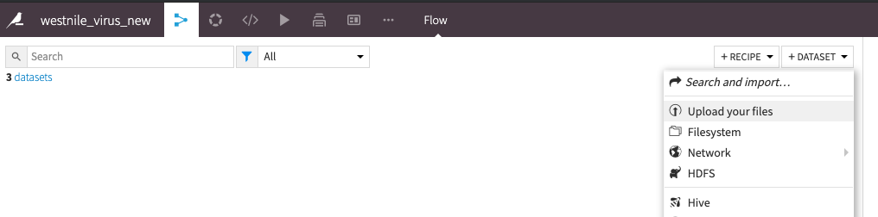
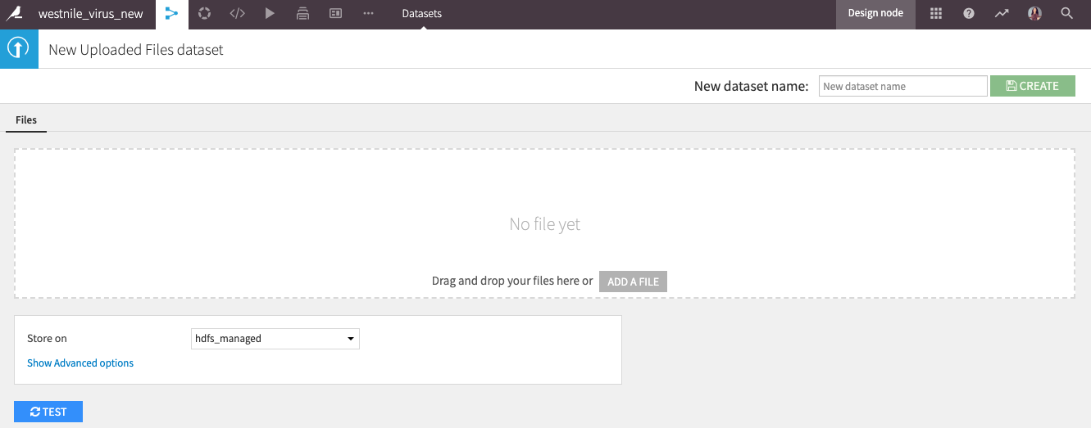
Let’s get the data...
upload datasets
And Finally, this data set is a csv file saved on your local machine
weather.csv.gz
http://bit.ly/nohanoha
Notes:
The Third dataset should be send to trainees as a CSV file saved on their local machines so they can upload it directly

Slide 23
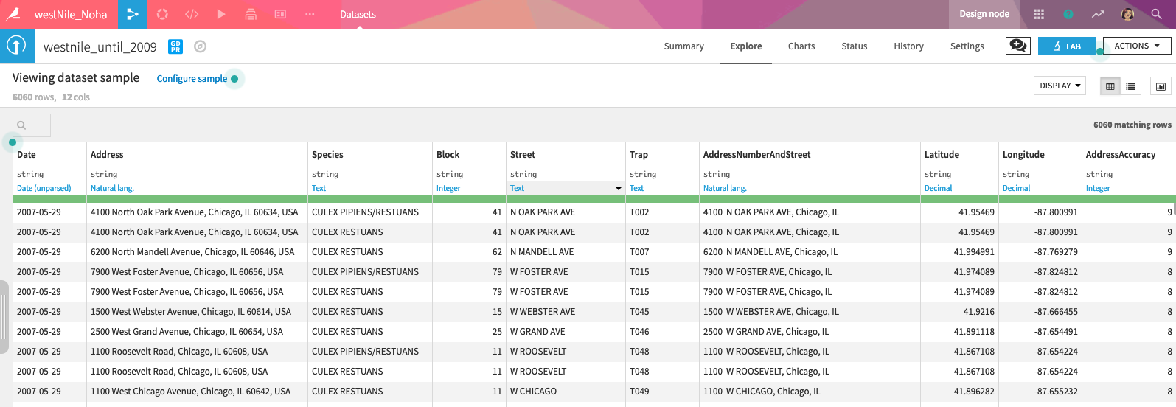
Some features to talk about
4
5
6
1
2
3
Notes:
be prepared to talk about each of those features and mark any other feature you feel relevant to the business you are training

Slide 24
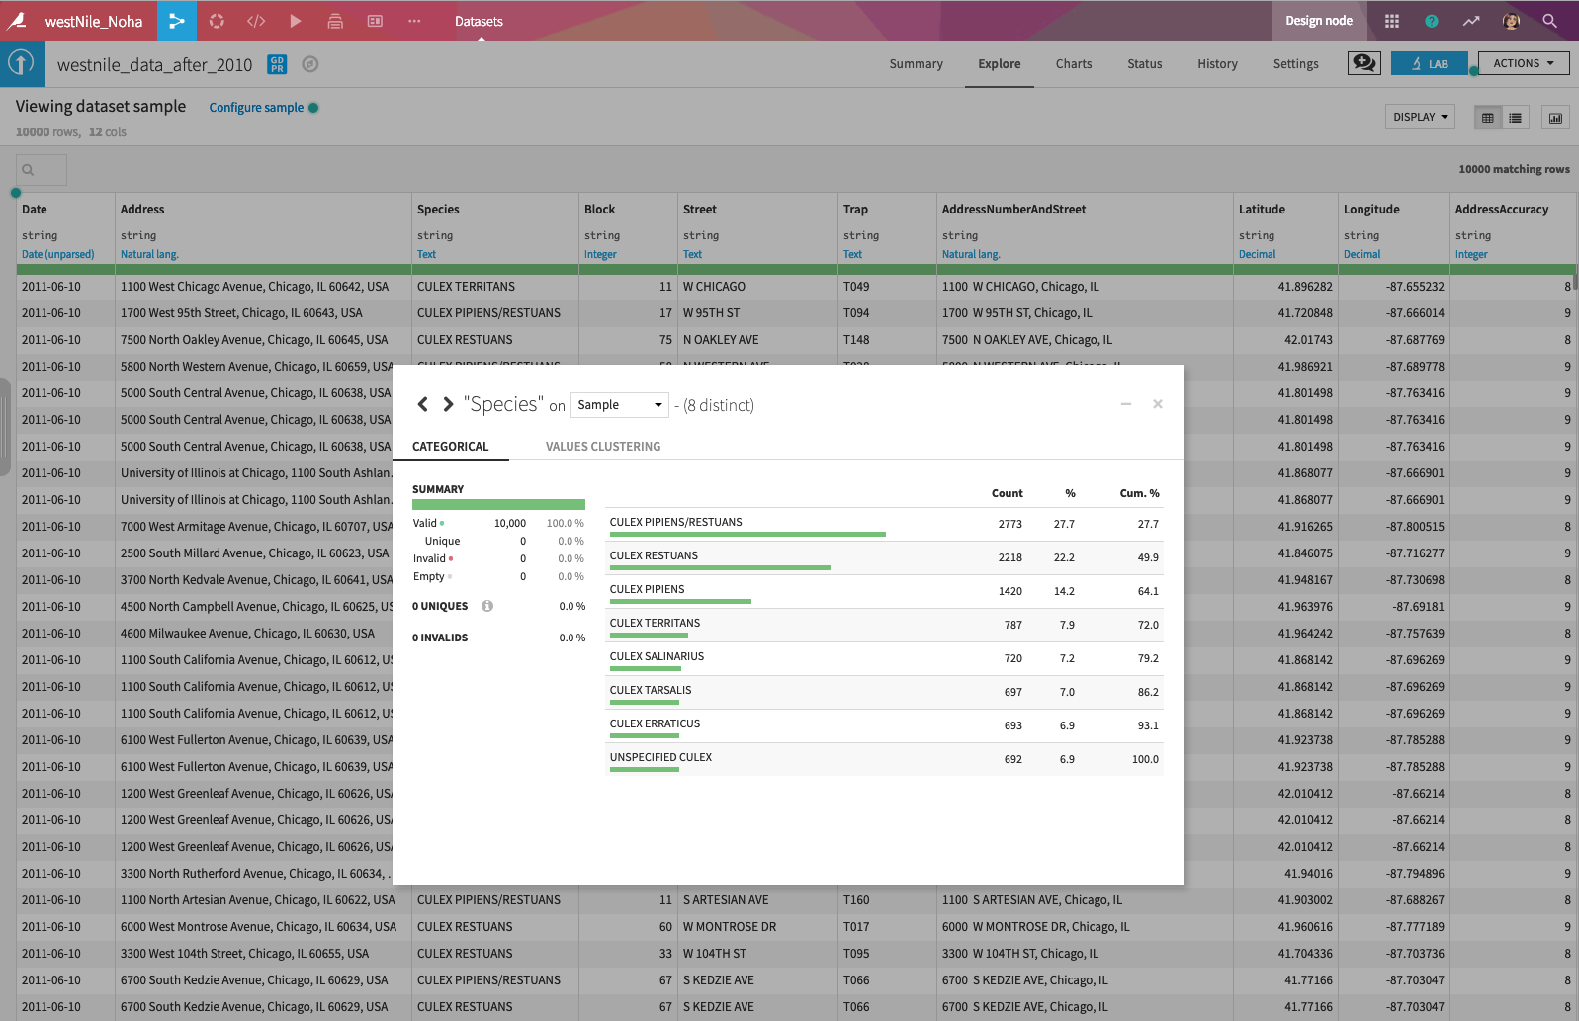
Some features to talk about
7
8
Notes:
thoroughly cover the Sampling vs Whole data concepts and specifically cover the computation and best practice related to this feature

Slide 25
Break!
Notes:
Use this slide at any point during the training based on the schedule and the timing you have planned for

